Slide 1




Bespoke Cache Enclaves: Fine-Grained and Scalable Isolation from Cache Side-Channels via Flexible Set-Partitioning
SEED 2021
Gururaj Saileshwar, Sanjay Kariyappa and Moinuddin Qureshi

Slide 2


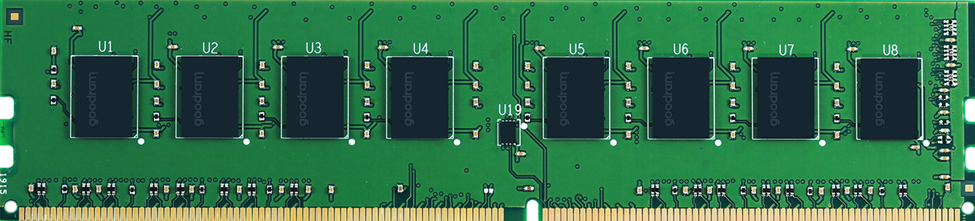
Problem: CPU Cache Side-Channels
CORE-0
CORE-1
Private
L1 Cache
L1 Cache
L2 Cache
L2 Cache
Shared
Last Level Cache (LLC)
LLC-Hit → Fast
LLC-Miss to DRAM → Slow
DRAM
Shared LLC helps improve performance,
But timing difference (LLC Hit vs Miss) leads to side-channels!

Slide 3

Problem: CPU Cache Side-Channels
CORE-0
CORE-1
L1 Cache
L1 Cache
SPY
PROCESS
VICTIM
PROCESS
L2 Cache
L2 Cache
Conflict-Based Attacks
Prime+Probe, Evict+Time,
Repl-Policy Attacks
Ways
A
Shared
Cache Set
B
Last Level Cache

Slide 4

Problem: CPU Cache Side-Channels
CORE-0
CORE-1
L1 Cache
L1 Cache
SPY
PROCESS
VICTIM
PROCESS
L2 Cache
L2 Cache
Conflict-Based Attacks
Prime+Probe, Evict+Time,
Repl-Policy Attacks
Secret-Dependent
A
V
Spy Lines Evicted due to Set Conflicts
B
B
Last Level Cache

Slide 5
Problem: CPU Cache Side-Channels
CORE-0
CORE-1
L1 Cache
L1 Cache
SPY
PROCESS
VICTIM
PROCESS
L2 Cache
L2 Cache
Conflict-Based Attacks
Hit
Install
Shared-Memory Attacks
Flush+Reload, Flush+Flush, …
V
Shared Cache Line
B
Spy has Cache Hits on
Lines Installed by Victim
Last Level Cache

Slide 6
Problem: CPU Cache Side-Channels
CORE-0
CORE-1
L1 Cache
L1 Cache
SPY
PROCESS
VICTIM
PROCESS
L2 Cache
L2 Cache
Conflict-Based Attacks
Shared-Memory Attacks
Sharing of Cache Space
Cache Occupancy Attack
Website-Fingerprinting
[SEC’20], [SEC’21]
Last Level Cache
Spy Infers Changes in Victim Working Set

Slide 7
Problem: CPU Cache Side-Channels
CORE-0
CORE-1
L1 Cache
L1 Cache
SPY
PROCESS
VICTIM
PROCESS
L2 Cache
L2 Cache
Conflict-Based Attacks
Shared-Memory Attacks
Sharing of Cache Space
Cache Occupancy Attack
Website-Fingerprinting
[SEC’20], [SEC’21]
Last Level Cache
Spy can Leak Victim Secrets like AES/RSA Keys, User Key-Strokes, Cause Privacy Breaches (fingerprint victim activity)

Slide 8
Landscape of Secure Cache Defenses
Randomization-Based
Partitioning-Based
Obfuscate Mapping of Lines to Sets
(e.g., CEASER(-s), ScatterCache, MIRAGE)
Isolate Cache Usage with Way/Set Partitioning
(e.g., DAWG, MI6)
Line
Install (X)
B
Rf
Sets
B
Incomplete Security
(do not prevent occupancy attacks)
Principled Security
Limited Scalability or Practicality
Our Focus

Slide 9
Drawbacks of Existing Partitioning Defenses
Way-Partitioning
Page-Coloring
Catalyst [HPCA’16], DAWG [MICRO’18]
STEALTHMEM [SEC’12], MI6 [MICRO’19]
Domain-Based
Way-Selection
Not Scalable (Number of Domains limited by LLC Associativity)

Slide 10
Drawbacks of Existing Partitioning Defenses
Way-Partitioning
Page-Coloring
Catalyst [HPCA’16], DAWG [MICRO’18]
STEALTHMEM [SEC’12], MI6 [MICRO’19]
Domain-Based
Way-Selection
Not Scalable (Number of Domains limited by LLC Associativity)
Not Flexible (Requires DRAM and LLC allocations in same ratio)
Implication: Limited Adoption in Real-world SW like Browsers

Slide 11
Drawbacks of Existing Partitioning Defenses
Way-Partitioning
Page-Coloring
DAWG [MICRO’18]
STEALTHMEM [SEC’12], MI6 [MICRO’19]
Domain-Based
Way-Selection
Not Scalable (Number of Domains limited by LLC Associativity)
Not Flexible (Requires DRAM and LLC allocations in same ratio)
GOAL:
Scalable to
100s of Domains
Fine-Grain Allocations
(granularity of few KBs)
Flexible Cache Allocations
(Independent of DRAM)

Slide 12
Our Solution: Bespoke Cache Enclaves
Cache Enclaves: Isolated Set Partitions of Arbitrary Size per Security Domain
Challenges:
Security: How to only Map Lines of a Domain to its own Cache Enclave?
Performance: How to Uniformly Map Lines within an Arbitrary-Sized Enclave?
Cluster
Dynamic LLC Indexing
Key Insight:
Flexible Dynamic Indexing
Fine-Grain: Allocations at “Cluster” Granularity (64 Sets)
Flexible: Size Independent of DRAM allocations
Scalable: 512 Cache Enclaves at a time in LLC

Slide 13
Overview of BCE Design
Allocation of LLC Resources Per Domain at a Cluster (64KB) Granularity
Interface:
Privileged Instructions
cache_alloc
cache_dealloc
OS/SW decides LLC allocation size, HW manages allocation and indexing

Slide 14
Overview of BCE Design
Allocation of LLC Resources Per Domain at a Cluster (64KB) Granularity
Dynamic LLC Indexing
in Hardware

Slide 15
Overview of BCE Design
Allocation of LLC Resources Per Domain at a Cluster (64KB) Granularity
Split indexing into (a) LineAddr → LCID and (b) LCID → PCID
Performance
Security
LLC Indexing in Hardware

Slide 16
Overview of BCE Design
Allocation of LLC Resources Per Domain at a Cluster (64KB) Granularity
Randomizing Hash Maps Line-Address → Logical Cluster (LCID)
Indirection Table Maps Clusters to LLC (LCID → PCID mapping)
LBH Minimizes
Set-Conflicts
CIM Guarantees Isolation & Security
LLC Indexing in Hardware

Slide 17
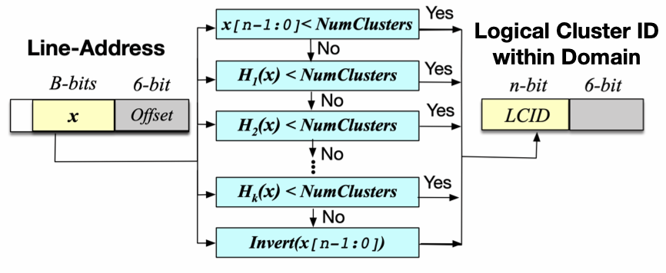
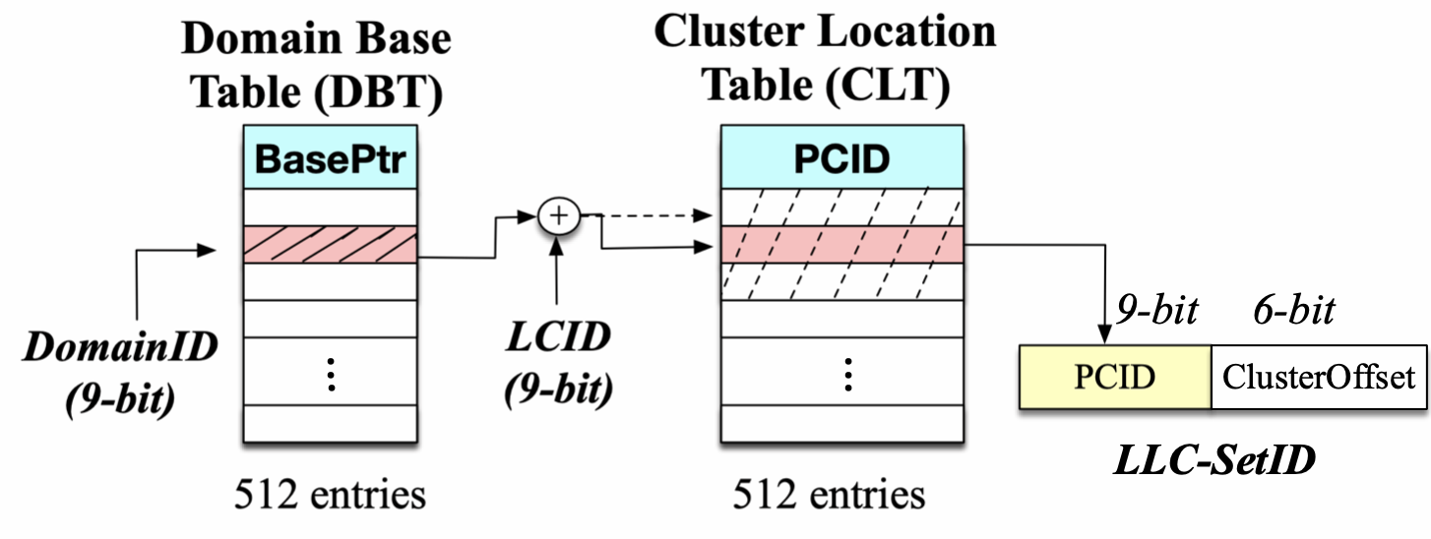
Deep-Dive: BCE Indexing
Load-Balancing Hash (LineAddr → LCID)
Cluster Indirection Module (LCID → PCID)
Multiple Randomizing Hashes: Minimizes Set-Conflicts by Uniformly Mapping LineAddr to Clusters
One-to-One Mapping: Isolation Based Security
2 Cycle Constant Latency Lookup (no new side-channel)
Minimal Storage Overhead (<2%) for Tables (2KB), 9-bits/tag to support 512 Domains
Detailed Explanations in the Paper

Slide 18
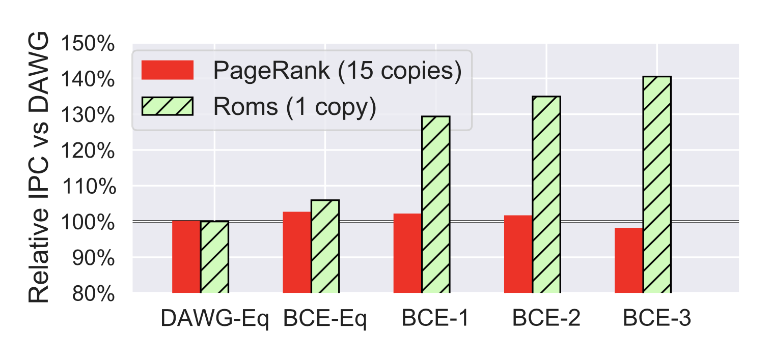
Results: Flexibility in LLC Allocation of BCE
Case Study: Benefits of BCE vs DAWG [MICRO’18]
15 Cache Insensitive (PageRank) & 1 Cache Sensitive (Roms) Workloads
Trace based simulation of 16-cores, 32MB LLC with 16 ways
40% IPC speedup vs DAWG for Roms by increasing its LLC allocation
Negligible impact on IPC of PageRank on squeezing its LLC allocation
LLC Per PageRank
2MB
2MB
1.5MB
1MB
0.5MB
LLC Per Roms
2MB
2MB
9.5MB
17MB
24.5MB
Increase Roms LLC by Squeezing PageRank LLC

Slide 19
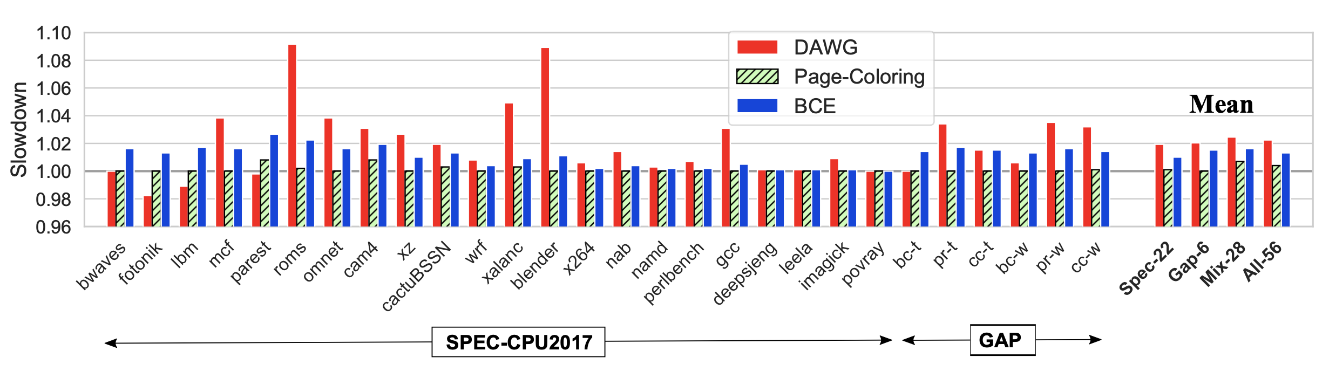
Results: Overall Performance
Slowdown for Equal-Partitioning vs Non-Secure Baseline
Trace based simulation of 16-cores, 32MB LLC with 16 ways
DAWG: 2%,
Page-Coloring: 0.4%
BCE: 1.4%
BCE has comparable slowdown (1.4%) as Page-Coloring (0.4%)
while allowing LLC allocation independent of DRAM allocation
Additional evaluations related to LLC Misses, LLC Latency, Storage Overheads in the Paper

Slide 20
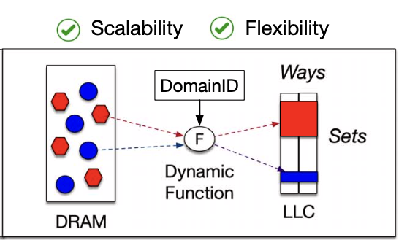
Summary
Cache Partitioning is a principled defense against cache side-channels
Prior Cache Partitioning Defenses are Impractical: Way-Partitioning not Scalable, Page-Coloring not Flexible
Bespoke Cache Enclaves: Flexible Set-Partitions via Dynamic Indexing
Practicality: Scalable to 512 cache enclaves, Fine-grain (64KB granularity allocation), Cache Allocation Independent of DRAM Allocations
Best-Case Performance: Upto 40% IPC improvement over DAWG with fine-grain sizing
Costs: On average, 1.4% slowdown vs non-secure baseline, 1.8% LLC storage overhead

